Slide 1



Predicting Loan Default Rate

Slide 2
PROJECT SCOPE
About Lending Club
Peer to peer Lending
User applies for loan and provided information about them
Objective
Predict given if loan is sanctioned, it will be defaulted or paid off

Slide 3
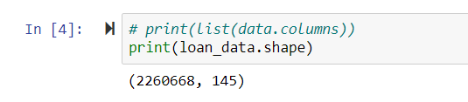
ABOUT DATASET
Dataset obtained from Kaggle.
Data set – More than 2.2 Million rows
Only 40% of data sampled from original dataset

Slide 4
ABOUT DATASET
Fields
Employment data like Job title, employment length, income
Interest rate, Grade, loan amount
Past inquiries , payment failures,
Mortgage info
Revolving balance, credit limit etc
Total 145 fields and not all useful

Slide 5
Data Cleaning Methodology
Dropping columns with more than 60% data
Analyzing columns with more than 10% missing data
Predicting missing values for columns with more than 10% missing data
Dropping rows with missing data
Dropping columns with unnecessary information
Payment date, issue date etc
Where more than 80% row contains same data
Eliminating unnecessary strings or words
Employment length line 5 year, 6 year to 5, 6 numeric

Slide 6

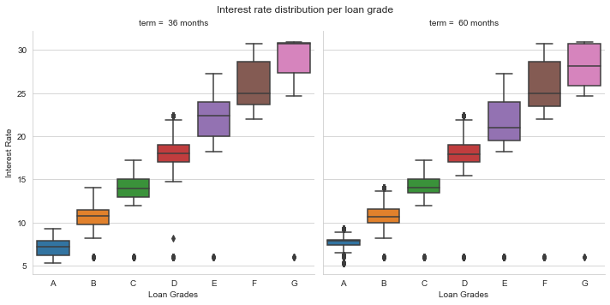



Exploratory Data Analysis

Slide 7
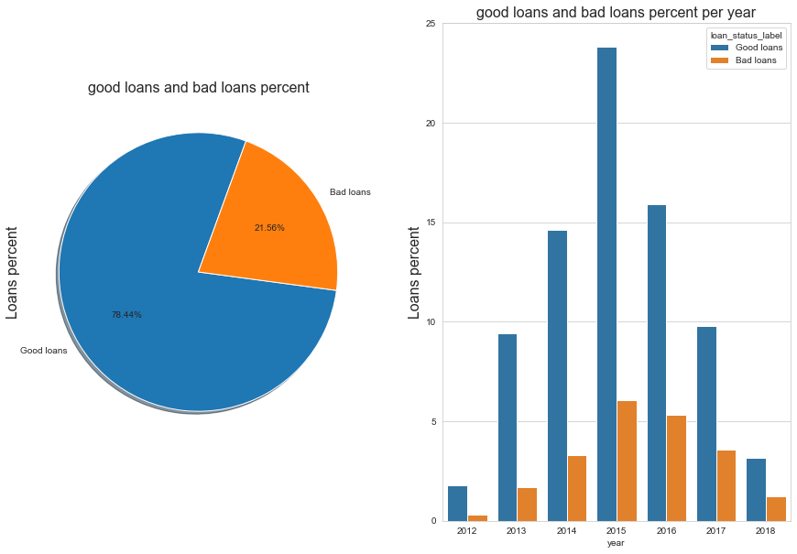
Exploratory Data Analysis

Slide 8
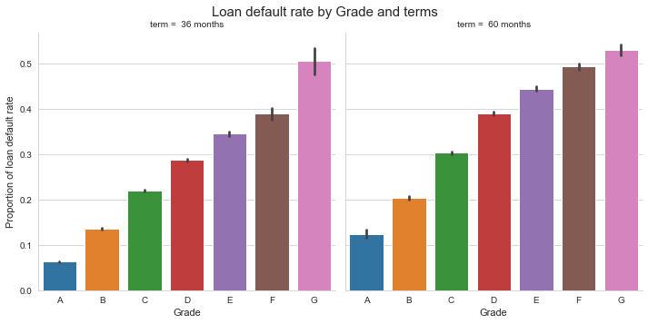
Exploratory Data Analysis

Slide 9
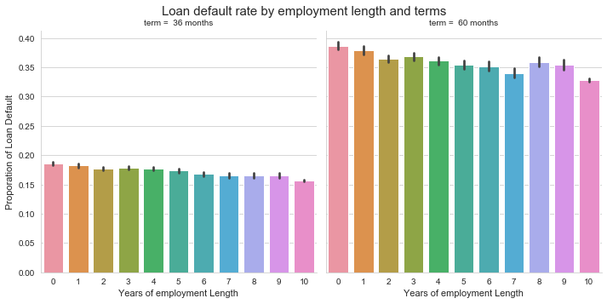
Exploratory Data Analysis

Slide 10
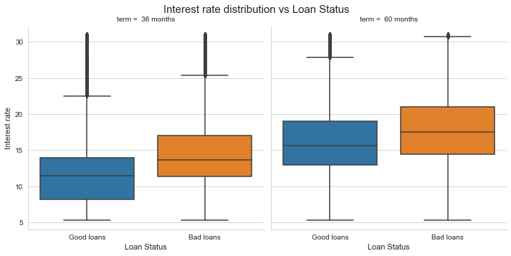
Exploratory Data Analysis

Slide 11
Exploratory Data Analysis
HOME_OWNERSHIP | ANY | MORTGAGE | OWN | RENT
LOAN_STATUS_LABEL
BAD LOANS | 0 | 0.44 | 0.11 | 0.46
GOOD LOANS | 0 | 0.52 | 0.1 | 0.38

Slide 12
Exploratory Data Analysis
HOME_OWNERSHIP | ANY | MORTGAGE | OWN | RENT
LOAN_STATUS_LABEL
BAD LOANS | 0 | 0.44 | 0.11 | 0.46
GOOD LOANS | 0 | 0.52 | 0.1 | 0.38

Slide 13
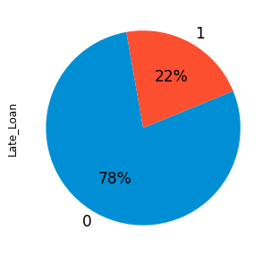
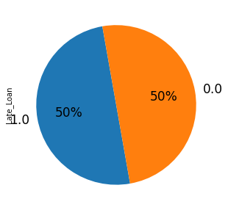
Distribution of labels
Labels are not balanced
Class 0 : 78%
Class 1 : 22%
SMOTE – Synthetic Minority Over Sampling Technique
Labels are balanced

Slide 14
Train and Test Data set
Test size = 0.3
Only 40% of data is used for developing machine learning model due to resource limitation
One Hot Encoding

Slide 15
Statistical Analysis
Loan grade and interest rate
EFFECT OF LOAN TERMS ON DEFAULT RATE
LOAN iNTEREST RATE VS LOAN STATUS

Slide 16
Machine Learning Model
List of Models
Logistic Regression
Gradient Boosting using XGBoost
Random Forest Classifier
Grid search is performed for each model
Metrics of Evaluation
Accuracy
F1 Score
ROC / AUC Curve for each model

Slide 17
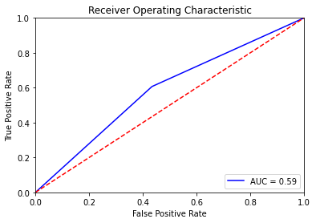
Logistic Regression
Train Accuracy = 0.586
Test Accuracy = 0.586
Confusion Metrics for Test Dataset
Class | Precision | Recall | F1-Score | Support
Default | 0.59 | 0.57 | 0.58 | 99735
Paid Off | 0.58 | 0.61 | 0.59 | 99855
Weighted Avg | 0.59 | 0.59 | 0.59 | 199590

Slide 18
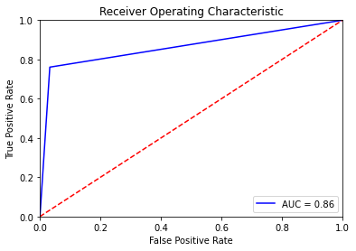
Gradient Boosting using XGBoost
Train Accuracy = 0.865
Test Accuracy = 0.864
Confusion Metrics for Test Dataset
Class | Precision | Recall | F1-Score | Support
Class | Precision | Recall | F1-Score | Support
Default | 0.8 | 0.97 | 0.88 | 99735
Paid Off | 0.96 | 0.76 | 0.85 | 99855
Weighted Avg | 0.88 | 0.86 | 0.86 | 199590

Slide 19
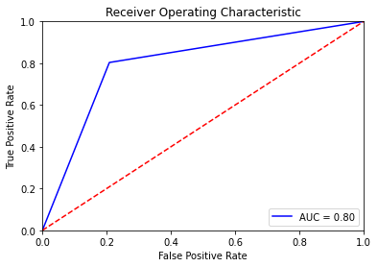
Random Forest Classifier
Train Accuracy = 1.0
Test Accuracy = 0.798
Confusion Metrics for Test Dataset
Class | Precision | Recall | F1-Score | Support
Default | 0.8 | 0.79 | 0.8 | 99735
Paid Off | 0.79 | 0.8 | 0.8 | 99855
Weighted Avg | 0.8 | 0.8 | 0.8 | 199590

Slide 20
Conclusion
XGBoost Performs better compared to Random forest and Logistic Regression classifier

Slide 21
Future Scope
Try to use different combination of features for different models
Run models using full datasets

